Slide 1
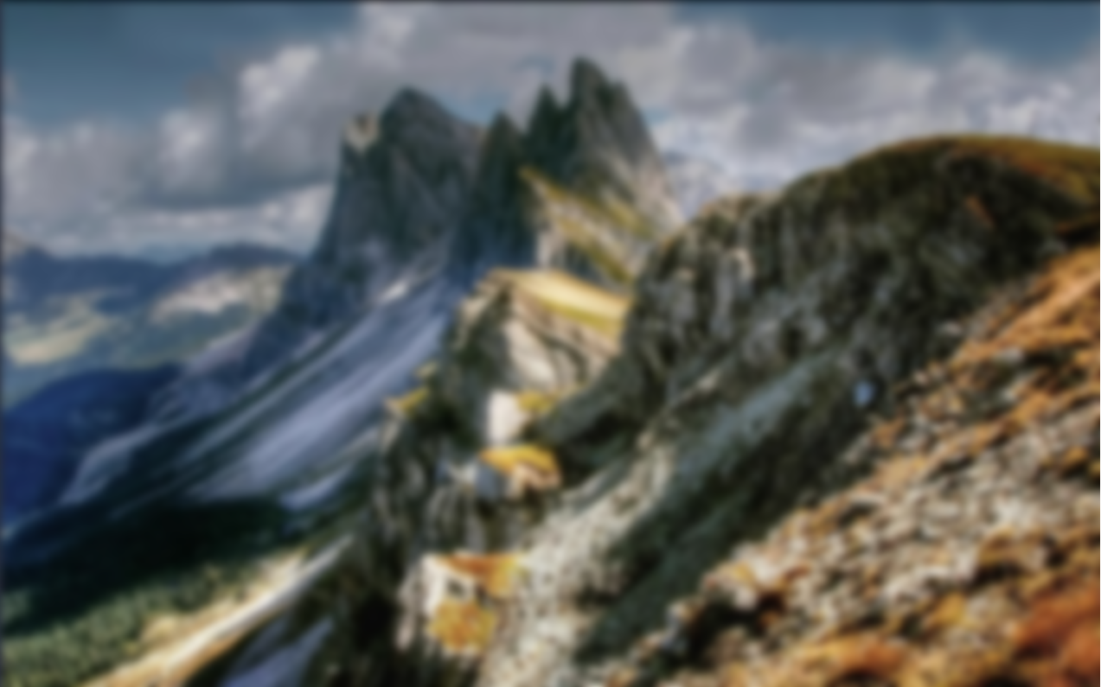
APTECH eProject | BATCH 2605 C1 | FINAL PRESENTATION | COMPLETED PROJECT
ALPINE
Ascents
An interactive educational mountaineering website
Web Design · UI/UX · Interactive Storytelling · Frontend Engineering
Notes:
Introduce the project, the team and that this is the final presentation.

Slide 2
01 / INTRODUCTION
THE PROBLEM
THE CHALLENGE
STUDENTS
Mountaineering knowledge is scattered across dense encyclopedias, outdated club sites, forums and news feeds.
Beginners struggle to build a clear picture of alpine history, technique and safety.
Alpine Ascents brings 11 sections into one scroll-driven experience.
Research and history timelines
BEGINNERS
Techniques, shelter and safety
HOBBYISTS
Quick access to records and clubs
Notes:
Mountaineering knowledge is scattered. Beginners cannot build a clear picture. Our site puts it in one place.

Slide 3
02 / STRATEGY
OBJECTIVES
CONTINUOUS FLOW
INTERACTIVE MODULES
One uninterrupted page instead of scattered links.
Timeline, panels, counters and a clubs map.
SCROLL STORYTELLING
CLEAR STRUCTURE
GSAP ScrollTrigger guides the reader step by step.
Eleven organised sections from history to safety guidelines.
Notes:
Four objectives drive every design decision.

Slide 4
03 / DESIGN SYSTEM
DESIGN DIRECTION
ICE WHITE #F2F8FB
TYPOGRAPHY
Anton for headlines, Bodoni Moda Italic for editorial quotes, Space Grotesk for body and data.
BLACK #000000
UI RULES
OCEAN BLUE #0B5ED7
Heavy 3-4px black borders, hard offset shadows with no blur, and square corners everywhere.
Notes:
Neo-brutalist editorial style, like a printed expedition field manual.

Slide 5
04 / ARCHITECTURE
SITE STRUCTURE
01 HISTORY
02 TYPES
03 TECHNIQUES
04 SHELTER
05 HAZARDS
06 RECORDS
07 CLUBS
08 SUCCESS STORIES
09 GALLERY
10 LATEST DEVELOPMENTS
11 GUIDELINES
Fixed header with scroll indicators · Alternating Ice White / Ocean Blue / Black sections · Bottom ticker bar
Notes:
Eleven sections in one flow, with a fixed header, colour rhythm and a bottom ticker.

Slide 6
05 / INTERACTION
SCROLL INTERACTIONS
HERO
HISTORY
TYPES
Frame grows from a windowed photo to full screen
Animated timeline starting at 1786
Expandable panels compare climbing styles
TECHNIQUES
SHELTER
RECORDS
Sticky visual while steps scroll
Image crossfade between tent, snow cave, bivouac, hut
Counters count up to 8,849m and 14 peaks
Notes:
Each interaction has a teaching purpose, not just decoration.

Slide 7
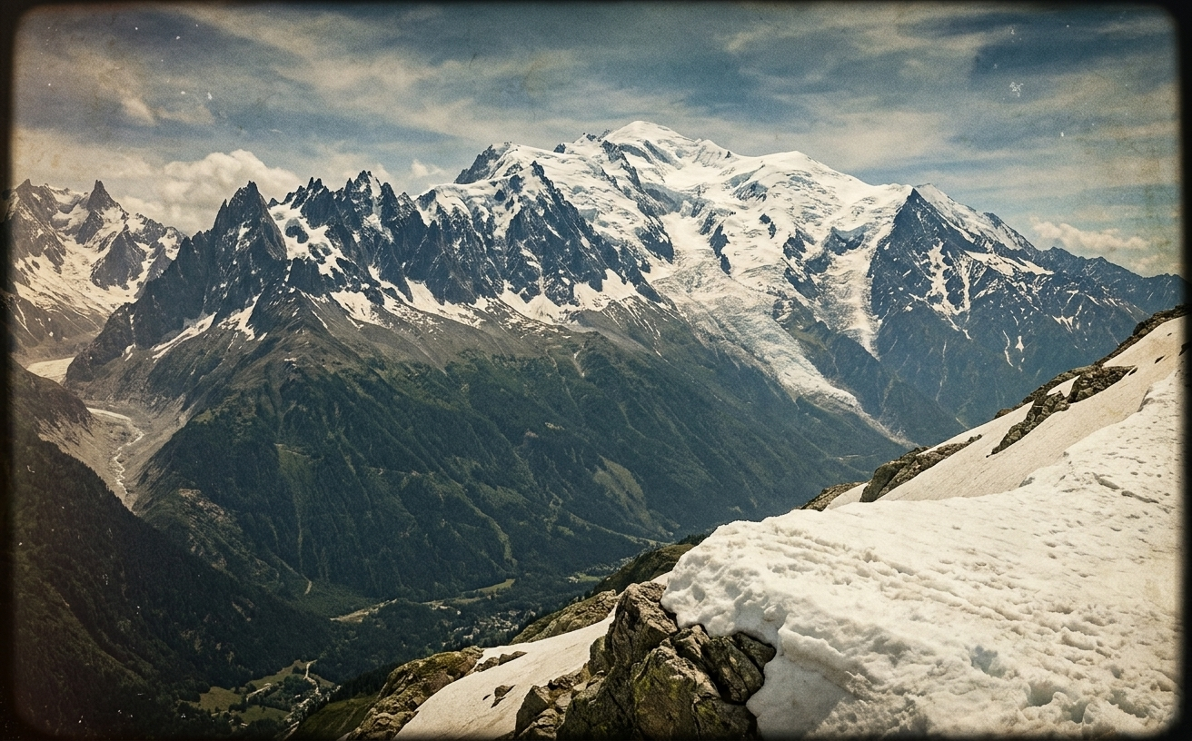
06 / CONTENT
HISTORY AND TECHNIQUES
HISTORY TIMELINE
TECHNIQUES
1786 First ascent of Mont Blanc
The Golden Age of Alpinism
Early Himalayan expeditions
The Everest era
Light, fast and modern climbing
01 Route finding
02 Anchoring
03 Belaying
04 Rappelling
Sticky visuals stay pinned while each step scrolls past.
Notes:
History runs from the first ascent of Mont Blanc in 1786 through the Golden Age and the Everest era. Techniques cover route finding, anchoring, belaying and rappelling.

Slide 8
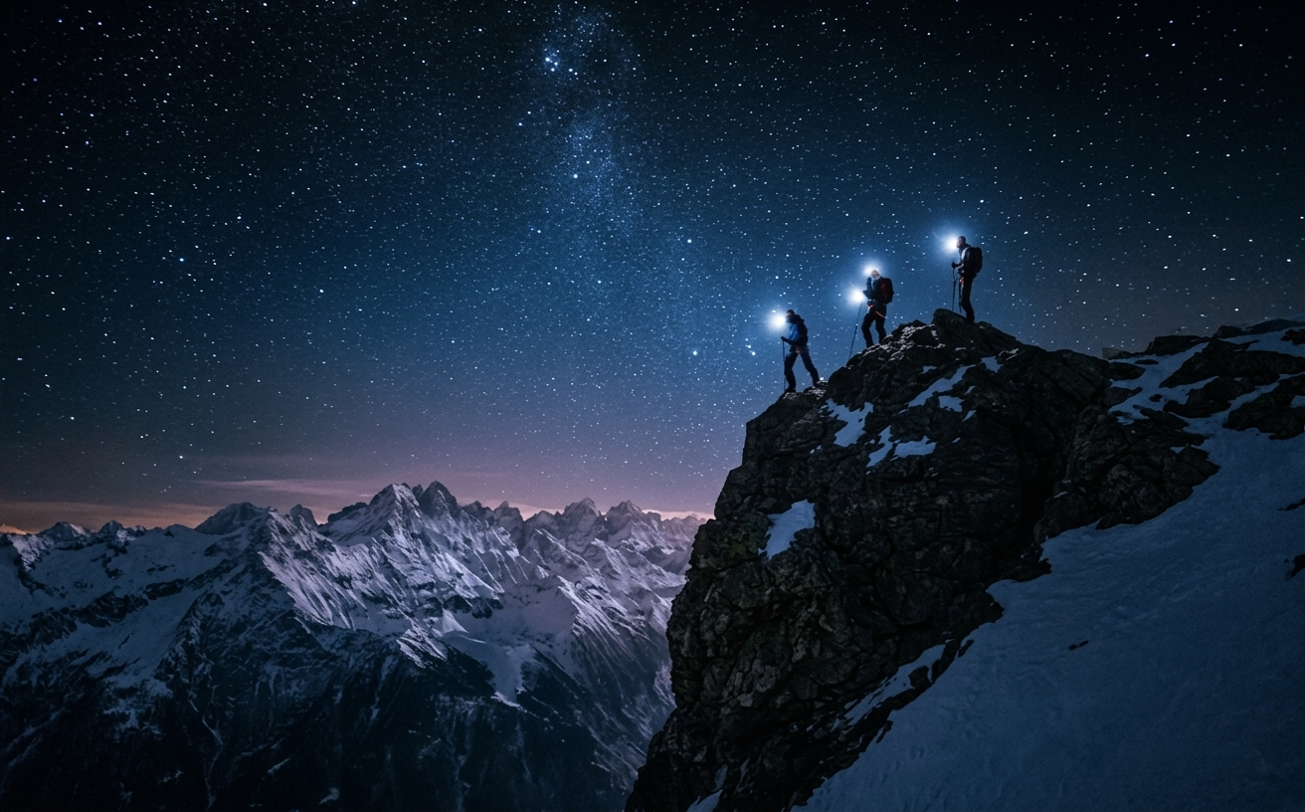
07 / CONTENT
HAZARDS AND RECORDS
HAZARDS
RECORDS
Avalanches, crevasses and altitude sickness, shown with giant outlined warning type on a black canvas.
Animated counters for 8,849m and the 14 highest peaks, plus milestone years for key firsts.
Notes:
Hazards use a dark canvas to feel serious. Records use animated counters.

Slide 9
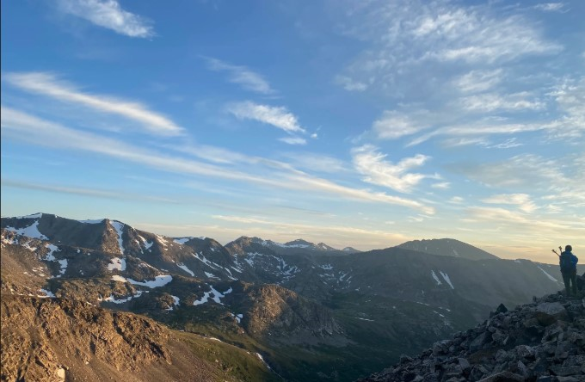
08 / GEOSPATIAL AND MEDIA
CLUBS MAP AND GALLERY
CLUBS EXPLORER
GALLERY AND STORIES
An interactive Leaflet map with custom neo-brutalist markers for The Alpine Club UK, the American Alpine Club and the Nepal Mountaineering Association.
Tiles: Esri Light Gray Canvas.
Asymmetric photo grid and a full-screen lightbox. Success Stories use large Bodoni quotes such as "One expedition, one route, two people on the summit."
Notes:
Leaflet with Esri Light Gray tiles shows real clubs. The gallery and success stories add visual proof.

Slide 10
09 / ENGINEERING
TECHNICAL STACK
HTML5
CSS3
VANILLA JS
Semantic structure
Grid, Flexbox, custom properties
ES6+ rendering and interaction
GSAP + SCROLLTRIGGER
LENIS
LEAFLET.JS
Scroll animations
Smooth inertial scrolling
Interactive clubs map
NO BACKEND · NO DATABASE · NO BUILD PIPELINE
Notes:
No backend, no database, no build step. Pure web standards plus four libraries.

Slide 11
10 / PROCESS
DEVELOPMENT JOURNEY
BUILD 1
BUILD 2
Comic-scene concept, discarded
Higher Ground-style concept, discarded
FRESH RESTART
MAP FIX
Neo-brutalist editorial manual, the final build
CARTO tiles, then OpenStreetMap, failed. Esri Light Gray now works.
Notes:
We restarted twice to reach a stronger idea, and fixed the map tiles after two providers failed.

Slide 12
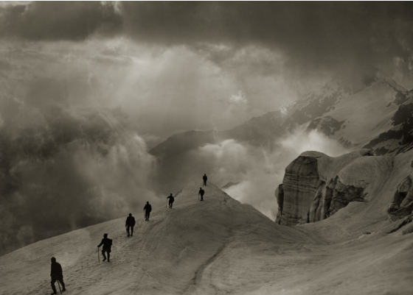
11 / QUALITY
TESTING AND ACCESSIBILITY
ACCESSIBILITY
Keyboard focus on custom controls
prefers-reduced-motion overrides
Strong black-on-white contrast
Touch-friendly targets (44px+)
RESPONSIVE
Layouts scale from desktop to tablet to mobile with no horizontal scroll.
Notes:
Only claims we can demonstrate are listed here.

Slide 13
12 / DELIVERABLES
DOCUMENTATION
PROBLEM DEFINITION
DESIGN SPECIFICATIONS
FLOWCHART
DATA FLOW DIAGRAM
TEST CASES
ASSUMPTIONS AND README
Notes:
Our eProject documents cover analysis, design and testing.

Slide 14
13 / PEOPLE
OUR TEAM
UZAIR NAUFIL
RIYAN AHMED
Student1730807
Student1731033
MUHAMMAD AHMED
SYED KHIZAR MUHAMMAD
Student1731035
Student1731034
Notes:
Introduce each team member and their student ID.

Slide 15
LIVE DEMO
Hero > History > Hazards > Clubs map > Gallery
PROJECT STATUS: COMPLETE
All 11 sections, interactions and the clubs map are built, tested and locked for final submission.
Alpine Ascents turns mountaineering knowledge into an interactive expedition.
Thank you - Questions and Discussion
Notes:
Live demo: hero, history, hazards, clubs map, gallery. Then summarise the completed project, then questions.

